Slide 1
Random Variable and its Probability Distribution

Slide 2
Random Variable
Given a sample space Ω, a random variable is defined as a function on Ω into the real line. In other words, a random variable assigns a real number to each possible outcome of Ω.

Slide 3
Example 1
E: Toss a coin thrice.
$Ω=\left\{HHH, HHT, HTH, THH, HTT, THT, TTH, TTT\right\}$.
Let X: Number of heads obtained in three tosses.
X(HHH) = 3, X(HHT) = 2, X(HTH) = 2, X(THH) = 2, X(HTT) = 1, X(THT) = 1, X(TTH) = 1, X(TTT) =0.
Here X is a random variable assuming the values 0, 1, 2, 3.

Slide 4
Example 2
E: Roll a die once.
$Ω=\{1,2,3,4,5,6\}$.
Let X(e) = e – 3.
X(1) = - 2, X(2) = - 1, X(3) = 0, X(4) = 1, X(5) = 2, X(6) = 3.
Here X is a random variable assuming the values -2, -1, 0, 1, 2, 3.

Slide 5
Example 3
E: Toss a coin until a Head appears.
$Ω=\{H,TH,TTH,TTTH,…\}$.
Let X: Number of tosses required to get the 1st Head.
X(H) = 1, X(TH) = 2, X(TTH) = 3, …..
Here X is a random variable assuming the values 1, 2, 3, …..

Slide 6
Example 4
E: Select a person at random from a group where each having height between 90 CM and 150 CM.
X: Height of the person selected.
Here X is a random variable that can assume an uncountably infinite number of values between 90 CM and 150 CM.

Slide 7
Discrete Random Variable
A random variable is said to be discrete if it can assume a finite number of values or countably infinite values.

Slide 8
Probability Distribution of a Discrete Random Variable
Let X be a discrete random variable assuming the values x₁, x₂, …, x_{n} (or x₁, x₂, …) with the corresponding probabilities p₁, p₂, …, p_{n} (or p₁, p₂, …) where $p_{i}=P\left(X=x_{i}\right)∀i$ such that $\sum_{i}{p_{i}}=1.$
The specification of the set of values of X together their corresponding probabilities define the discrete probability distribution of X.

Slide 9
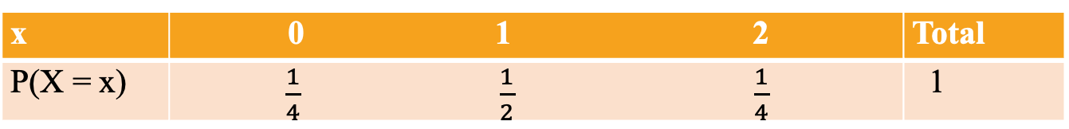
Example 1
E: Toss an unbiased coin twice.
Ω={HH, HT, TH, TT}
Let X: Number of heads obtained in two tosses.
Here X can take up the values 0, 1 and 2.
Now, P(X=0)=P(TT)=1/4,P(X=1)=P(HT or TH)=1/2,P(X=2)=1/4.
The probability distribution of X is then given by
x | 0 1 2 | Total
P(X = x) | $\frac{1}{4}$ $\frac{1}{2}$ $\frac{1}{4}$ | 1

Slide 10
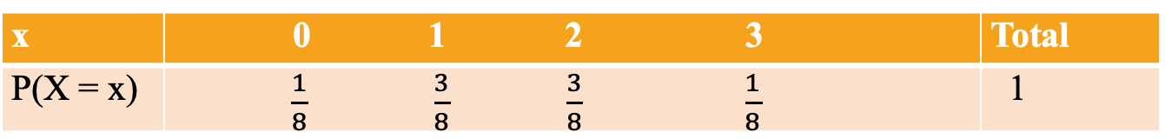
Example 2
E: Toss an unbiased coin thrice.
$Ω=\left\{HHH, HHT, HTH, THH, HTT, THT, TTH, TTT\right\}$.
Let X: Number of heads obtained in three tosses.
Here X can assume the values 0, 1, 2, 3.
Now, $P\left(X=0\right)=P\left(TTT\right)=\frac{1}{8}, P\left(X=1\right)=P\left(HTT or THT or TTH\right)=\frac{3}{8}, P\left(X=2\right)=P\left(HHT or HTH or THH\right)=\frac{3}{8}, P\left(X=3\right)=P\left(HHH\right)=\frac{1}{8}$.
The probability distribution of X is then given by
x | 0 1 2 3 | Total
P(X = x) | $\frac{1}{8}$ $\frac{3}{8}$ $\frac{3}{8}$ $\frac{1}{8}$ | 1

Slide 11
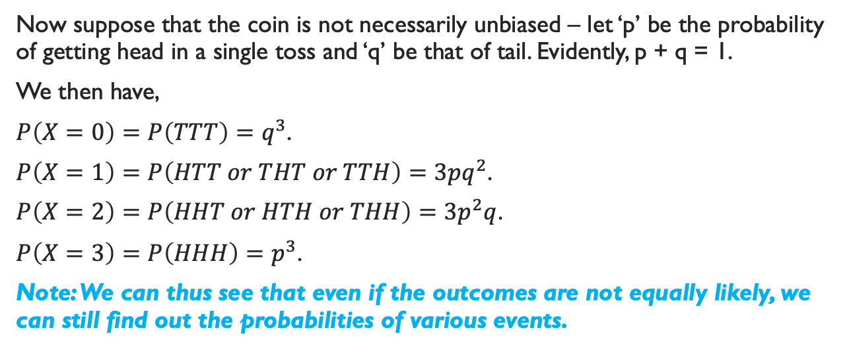
Example 2 (Continued)
Now suppose that the coin is not necessarily unbiased – let ‘p’ be the probability of getting head in a single toss and ‘q’ be that of tail. Evidently, p + q = 1.
We then have,
$P\left(X=0\right)=P\left(TTT\right)=q^{3}$.
$P\left(X=1\right)=P\left(HTT or THT or TTH\right)=3pq^{2}$.
$P\left(X=2\right)=P\left(HHT or HTH or THH\right)=3p^{2}q$.
$P\left(X=3\right)=P\left(HHH\right)=p^{3}$.
Note: We can thus see that even if the outcomes are not equally likely, we can still find out the probabilities of various events.

Slide 12
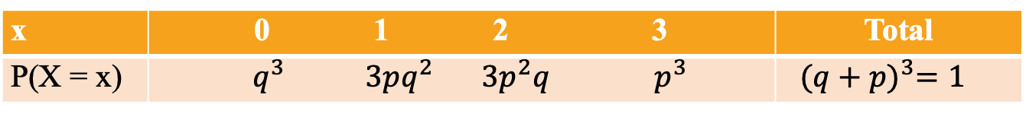
Example 2 (Continued)
Now, the probability distribution of X is given by
x | 0 1 2 3 | Total
P(X = x) | $q^{3}$ $3pq^{2}$ $3p^{2}q$ $p^{3}$ | ${(q+p)}^{3}=1$

Slide 13
Example 3
E: Toss a coin until a Head appears.
Let ‘p’ be the probability of getting head in a single toss and ‘q’ be that of tail.
$Ω=\{H,TH,TTH,TTTH,…\}$.
Let X: Number of tails preceding the the 1st Head.
Here X can assume the values 0, 1, 2, 3, …..
Here the probability distribution of X is given by
x | 0 1 2 3 ….. | Total
P(X = x) | $p$ $qp$ $q^{2}p$ $q^{3}p$ ….. | 1

Slide 14
Note
We thus see that even if the sample space is infinite, one can obtain the probabilities of different values of the random variable.

Slide 15
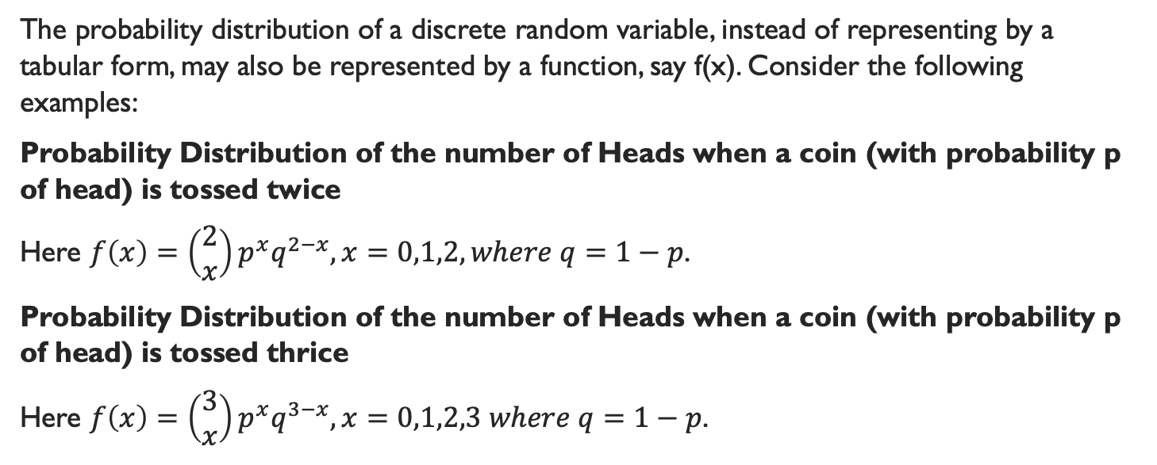
Alternative Representation of Probability Distribution of a Discrete Random Variable
The probability distribution of a discrete random variable, instead of representing by a tabular form, may also be represented by a function, say f(x). Consider the following examples:
Probability Distribution of the number of Heads when a coin (with probability p of head) is tossed twice
Here $f\left(x\right)=\left(\begin{matrix}2 \\ x\end{matrix}\right)p^{x}q^{2−x}, x=0,1,2, where q=1−p$.
Probability Distribution of the number of Heads when a coin (with probability p of head) is tossed thrice
Here $f\left(x\right)=\left(\begin{matrix}3 \\ x\end{matrix}\right)p^{x}q^{3−x}, x=0,1,2,3 where q=1−p$.

Slide 16
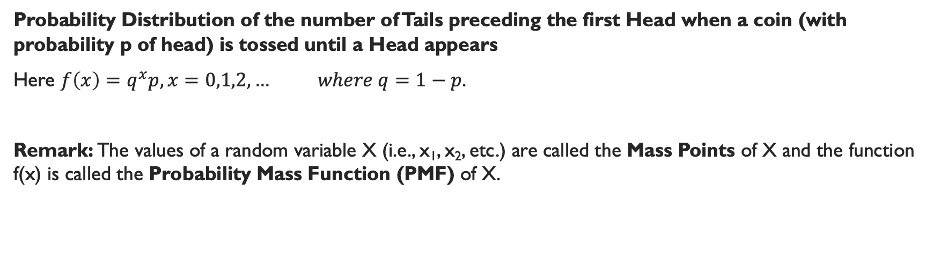
Alternative Representation of Probability Distribution of a Discrete Random Variable Contd.
Probability Distribution of the number of Tails preceding the first Head when a coin (with probability p of head) is tossed until a Head appears
Here $f\left(x\right)=q^{x}p,x=0,1,2,… where q=1−p$.
Remark: The values of a random variable X (i.e., x₁, x₂, etc.) are called the Mass Points of X and the function f(x) is called the Probability Mass Function (PMF) of X.

Slide 17
Probability Mass Function (PMF)
A function f(x) is said to be the PMF of a discrete random variable X if
$f\left(x\right)≥0 ∀x$
$\sum_{x}{f(x)}=1$
where $f\left(x\right)=P\left(X=x\right)∀x$

Slide 18
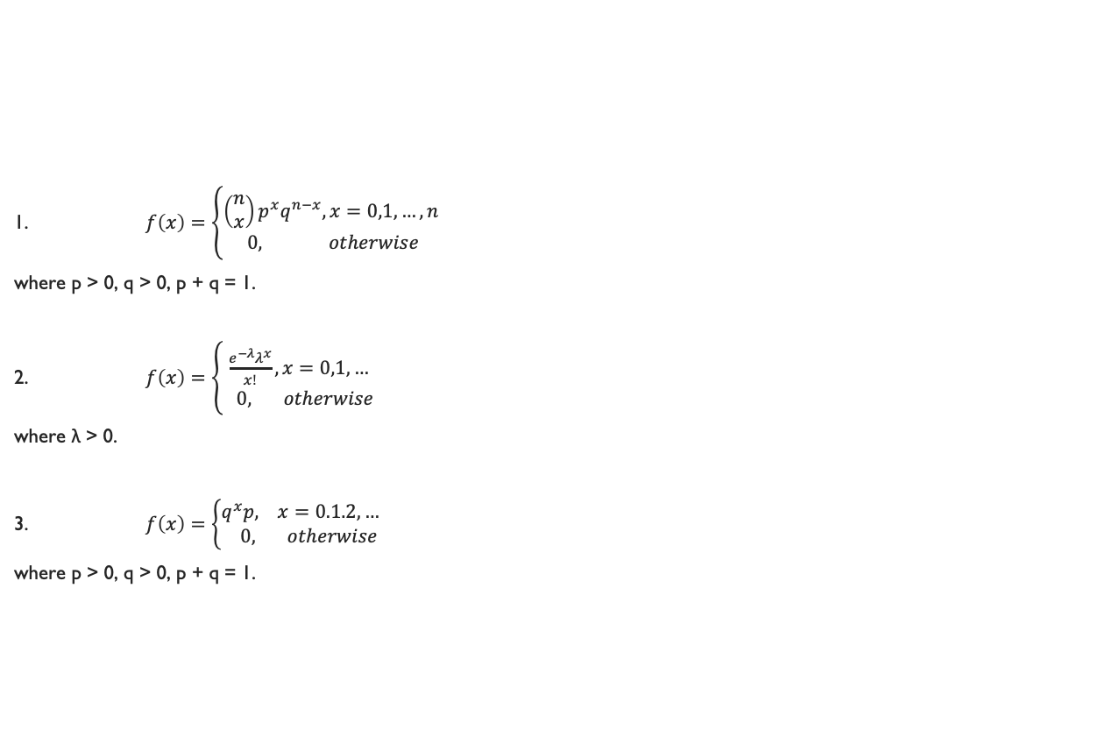
Question: Verify whether the following are PMF:
1. $f\left(x\right)=\left\{\begin{matrix}\left(\begin{matrix}n \\ x\end{matrix}\right)p^{x}q^{n−x}, x=0,1,…,n \\ 0, otherwise\end{matrix}\right.$
where p > 0, q > 0, p + q = 1.
2. $f\left(x\right)=\left\{\begin{matrix}\frac{e^{−λ}λ^{x}}{x!}, x=0,1,… \\ 0, otherwise\end{matrix}\right.$
where λ > 0.
3. $f\left(x\right)=\left\{\begin{matrix}q^{x}p, x=0.1.2,… \\ 0, otherwise\end{matrix}\right.$
where p > 0, q > 0, p + q = 1.

Slide 19
Measures on a Discrete Probability Distribution

Slide 20
Measures of Central Tendency

Slide 21
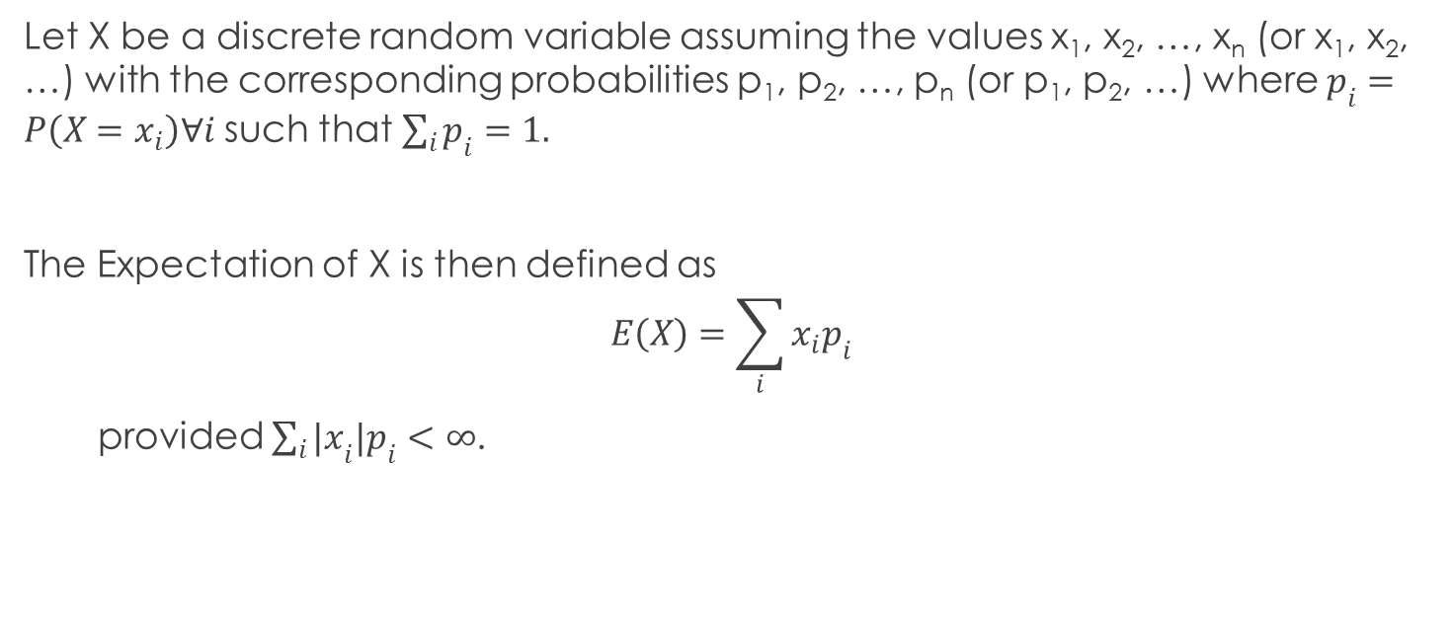
Expectation (or Mathematical Expectation)
Let X be a discrete random variable assuming the values x₁, x₂, …, x_{n} (or x₁, x₂, …) with the corresponding probabilities p₁, p₂, …, p_{n} (or p₁, p₂, …) where $p_{i}=P\left(X=x_{i}\right)∀i$ such that $\sum_{i}{p_{i}}=1.$
The Expectation of X is then defined as
$$E\left(X\right)=\sum_{i}{x_{i}p_{i}}$$
provided $\sum_{i}{{|x}_{i}|p_{i}}<∞$.

Slide 22
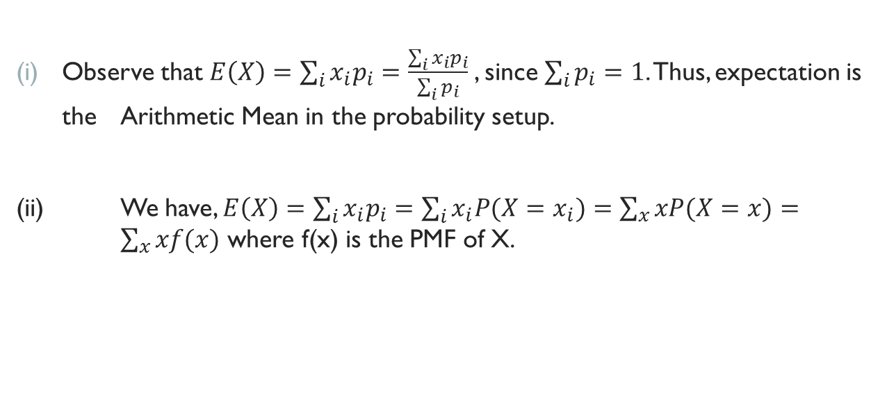
Notes
Observe that $E\left(X\right)=\sum_{i}{x_{i}p_{i}}=\frac{\sum_{i}{x_{i}p_{i}}}{\sum_{i}{p_{i}}}$, since $\sum_{i}{p_{i}}=1$. Thus, expectation is the Arithmetic Mean in the probability setup.
(ii) We have, $E\left(X\right)=\sum_{i}{x_{i}p_{i}}=\sum_{i}{x_{i}P(X=x_{i})}=\sum_{x}{xP(X=x)}= \sum_{x}{xf(x)}$ where f(x) is the PMF of X.

Slide 23
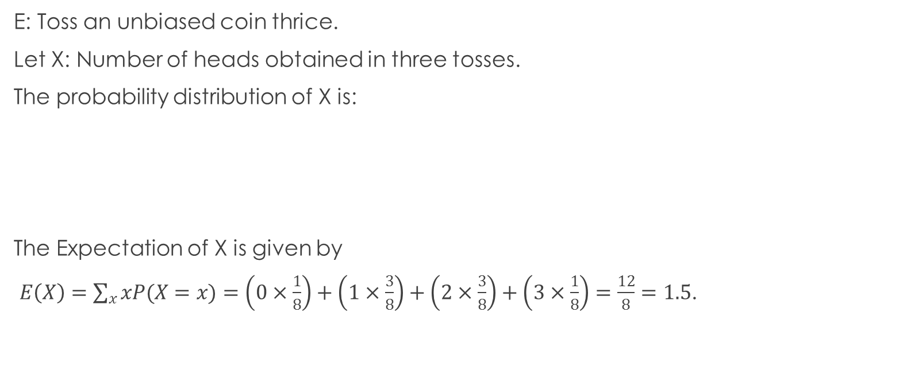
Example
E: Toss an unbiased coin thrice.
Let X: Number of heads obtained in three tosses.
The probability distribution of X is:
The Expectation of X is given by
$E\left(X\right)=\sum_{x}{xP(X=x)}=\left(0×\frac{1}{8}\right)+\left(1×\frac{3}{8}\right)+\left(2×\frac{3}{8}\right)+\left(3×\frac{1}{8}\right)=\frac{12}{8}=1.5$.
x | 0 | 1 | 2 | 3 | Total
P(X = x) | 1/8 | 3/8 | 3/8 | 1/8 | 1

Slide 24
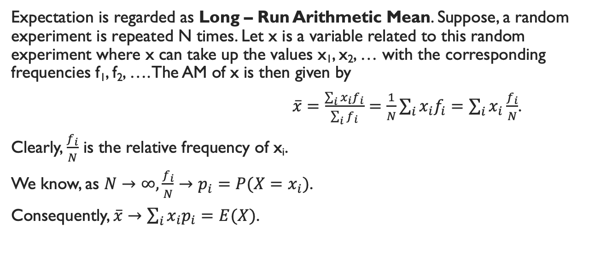
Note
Expectation is regarded as Long – Run Arithmetic Mean. Suppose, a random experiment is repeated N times. Let x is a variable related to this random experiment where x can take up the values x₁, x₂, … with the corresponding frequencies f₁, f₂, …. The AM of x is then given by
$\overline{x}=\frac{\sum_{i}{x_{i}f_{i}}}{\sum_{i}{f_{i}}}=\frac{1}{N}\sum_{i}{x_{i}f_{i}}=\sum_{i}{x_{i}\frac{f_{i}}{N}}$.
Clearly, $\frac{f_{i}}{N}$ is the relative frequency of x_{i}.
We know, as $N→∞, \frac{f_{i}}{N}→p_{i}=P(X=x_{i})$.
Consequently, $\overline{x}→\sum_{i}{x_{i}p_{i}}=E(X)$.

Slide 25
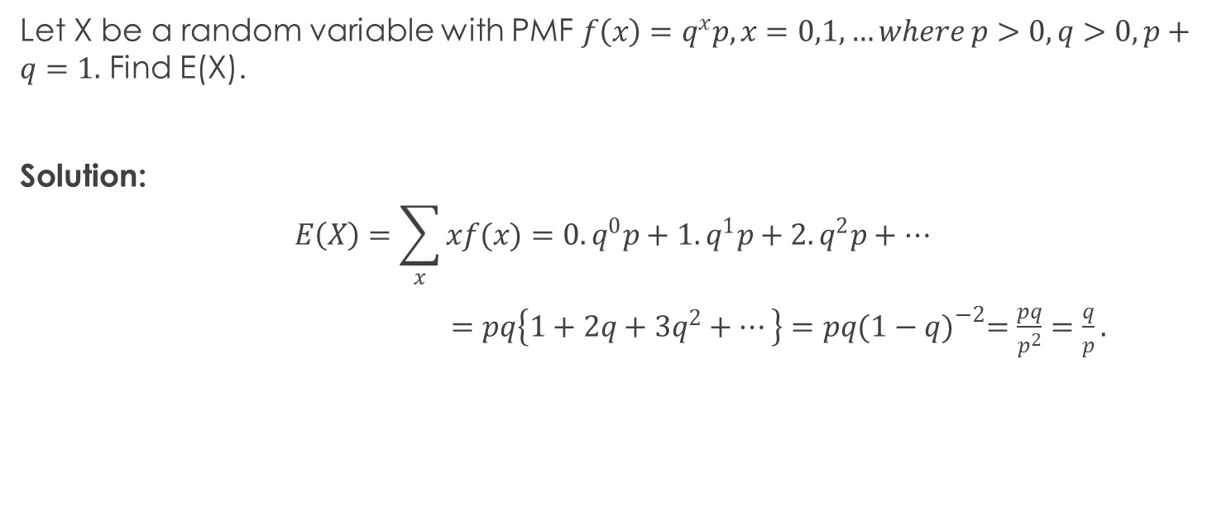
Example
Let X be a random variable with PMF $f\left(x\right)=q^{x}p, x=0,1,…where p>0,q>0,p+q=1.$ Find E(X).
Solution:
$$E\left(X\right)=\sum_{x}{xf(x)}=0.q^{0}p+1.q^{1}p+2.q^{2}p+…$$
$=pq\left\{1+2q+3q^{2}+…\right\}=pq{(1−q)}^{−2}=\frac{pq}{p^{2}}=\frac{q}{p}.$

Slide 26
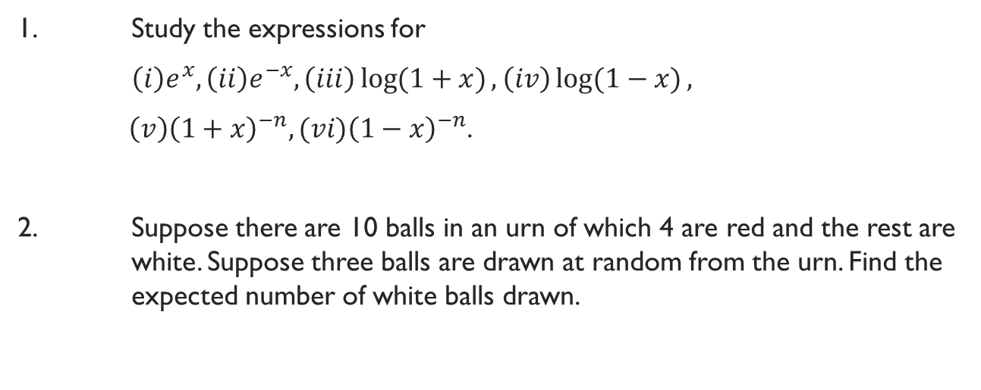
Home Task
1. Study the expressions for
$\left(i\right)e^{x},\left(ii\right)e^{−x}, \left(iii\right)\log{(1+x)}, \left(iv\right)\log{(1−x)},$
$\left(v\right){\left(1+x\right)}^{−n},(vi){\left(1−x\right)}^{−n}$.
2. Suppose there are 10 balls in an urn of which 4 are red and the rest are white. Suppose three balls are drawn at random from the urn. Find the expected number of white balls drawn.

Slide 27
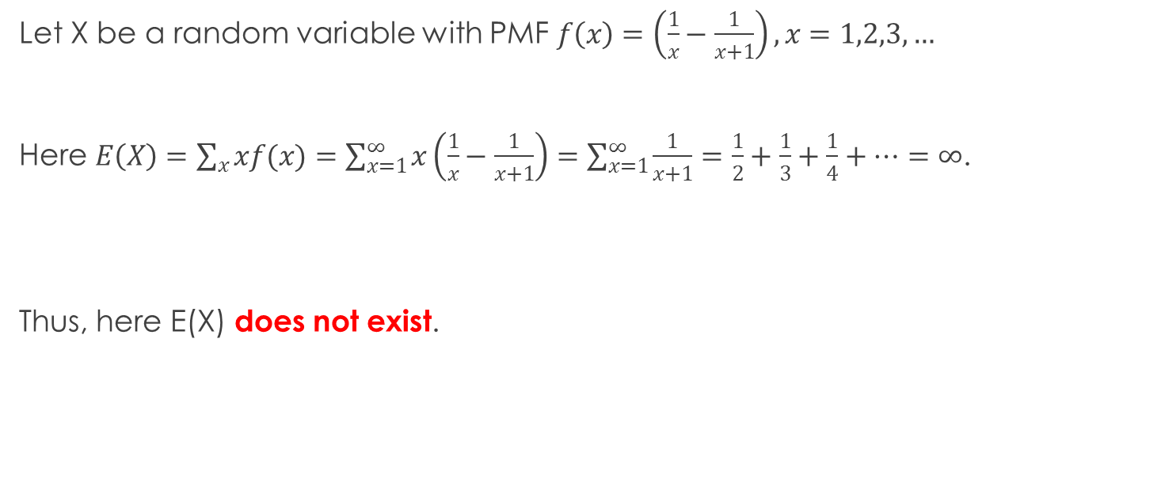
An Important Example
Let X be a random variable with PMF $f\left(x\right)=\left(\frac{1}{x}−\frac{1}{x+1}\right),x=1,2,3,…$
Here $E\left(X\right)=\sum_{x}{xf(x)}=\sum_{x=1}^{∞}{x\left(\frac{1}{x}−\frac{1}{x+1}\right)}=\sum_{x=1}^{∞}{\frac{1}{x+1}}=\frac{1}{2}+\frac{1}{3}+\frac{1}{4}+…=∞$.
Thus, here E(X) does not exist.

Slide 28
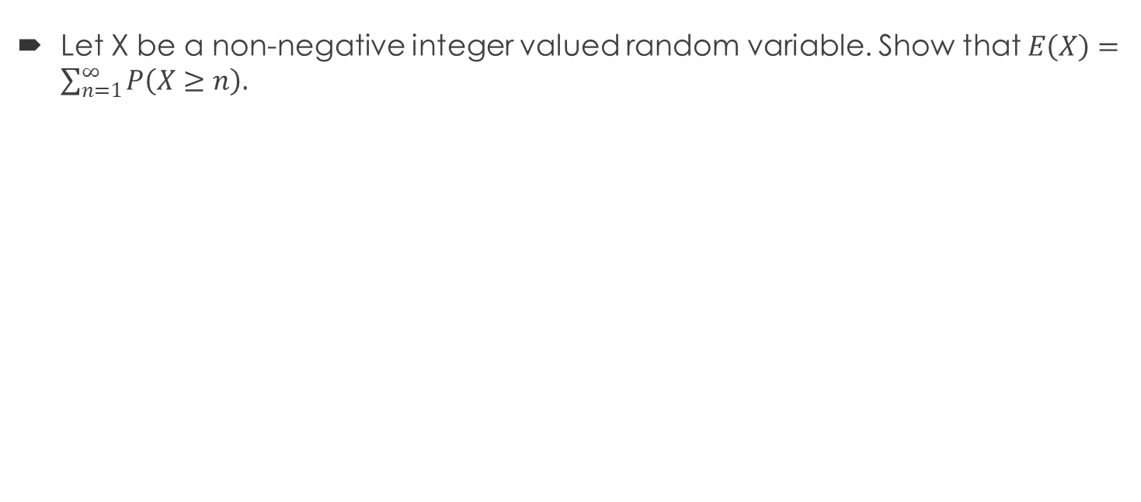
Exercise
Let X be a non-negative integer valued random variable. Show that $E\left(X\right)=\sum_{n=1}^{∞}{P\left(X≥n\right).}$

Slide 29
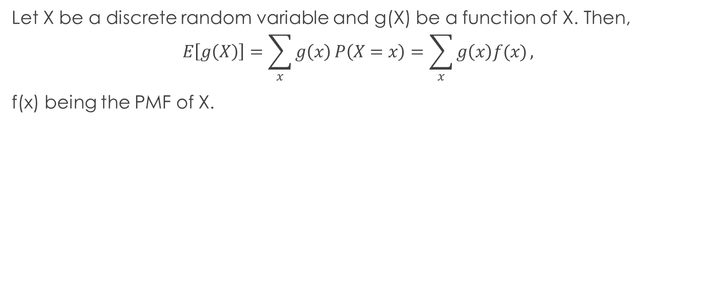
Definition
Let X be a discrete random variable and g(X) be a function of X. Then,
$$E\left[g\left(X\right)\right]=\sum_{x}{g\left(x\right)}P\left(X=x\right)=\sum_{x}{g\left(x\right)f(x)},$$
f(x) being the PMF of X.

Slide 30
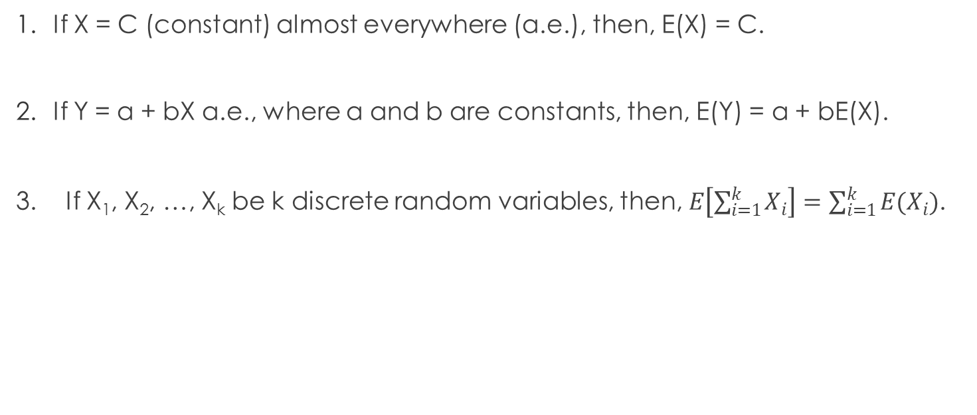
Properties of Expectation
If X = C (constant) almost everywhere (a.e.), then, E(X) = C.
If Y = a + bX a.e., where a and b are constants, then, E(Y) = a + bE(X).
3. If X₁, X₂, …, X_{k} be k discrete random variables, then, $E\left[\sum_{i=1}^{k}{X_{i}}\right]=\sum_{i=1}^{k}{E(X_{i})}$.

Slide 31
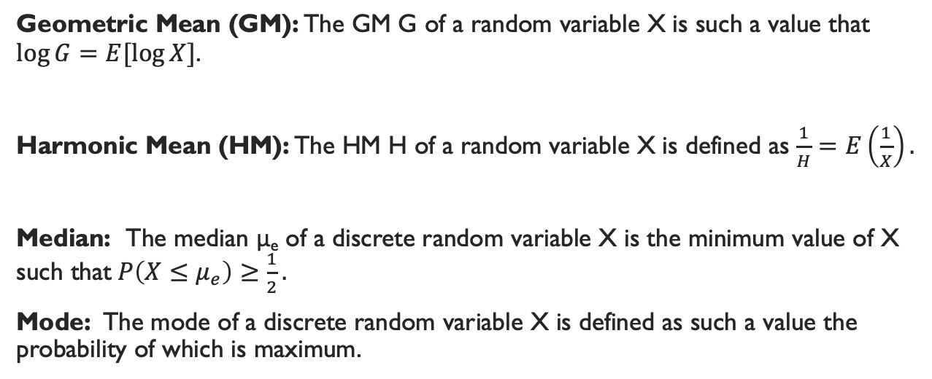
Other Measures of Central Tendency
Geometric Mean (GM): The GM G of a random variable X is such a value that $\log{G}=E[\log{X}]$.
Harmonic Mean (HM): The HM H of a random variable X is defined as $\frac{1}{H}=E\left(\frac{1}{X}\right).$
Median: The median μ_{e} of a discrete random variable X is the minimum value of X such that$P\left(X≤μ_{e}\right)≥\frac{1}{2}.$
Mode: The mode of a discrete random variable X is defined as such a value the probability of which is maximum.

Slide 32
Measures of Dispersion

Slide 33
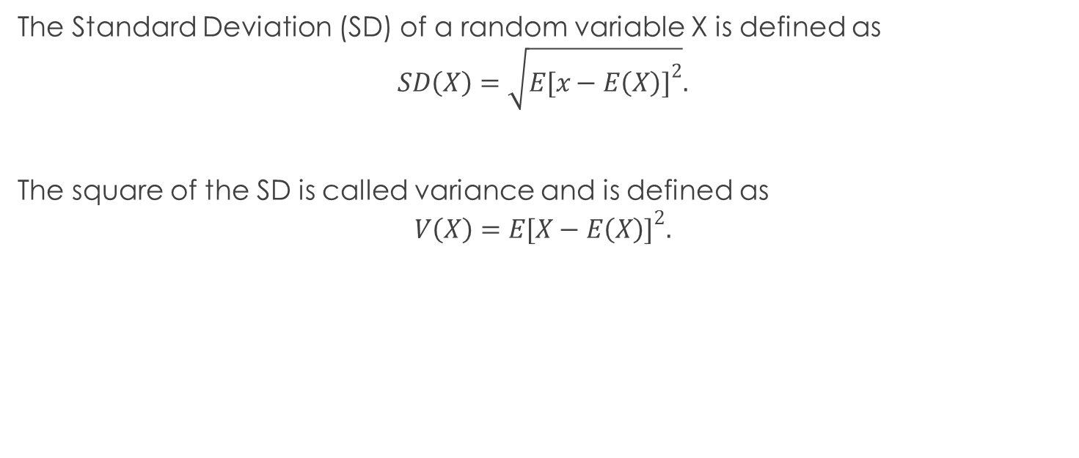
Standard Deviation
The Standard Deviation (SD) of a random variable X is defined as
$$SD\left(X\right)=\sqrt{E{[x−E\left(X\right)]}^{2}}.$$
The square of the SD is called variance and is defined as
$$V\left(X\right)=E{[X−E\left(X\right)]}^{2}.$$

Slide 34

Computational Formula of Variance
$$V\left(X\right)=E{[X−E\left(X\right)]}^{2}$$
$$=E[X^{2}−2XE\left(X\right)+{\left\{E\left(X\right)\right\}}^{2}]$$
$=E\left(X^{2}\right)−2E\left(X\right)E\left(X\right)+{\left\{E\left(X\right)\right\}}^{2}$
$$=E\left(X^{2}\right)−{\left\{E\left(X\right)\right\}}^{2}$$

Slide 35
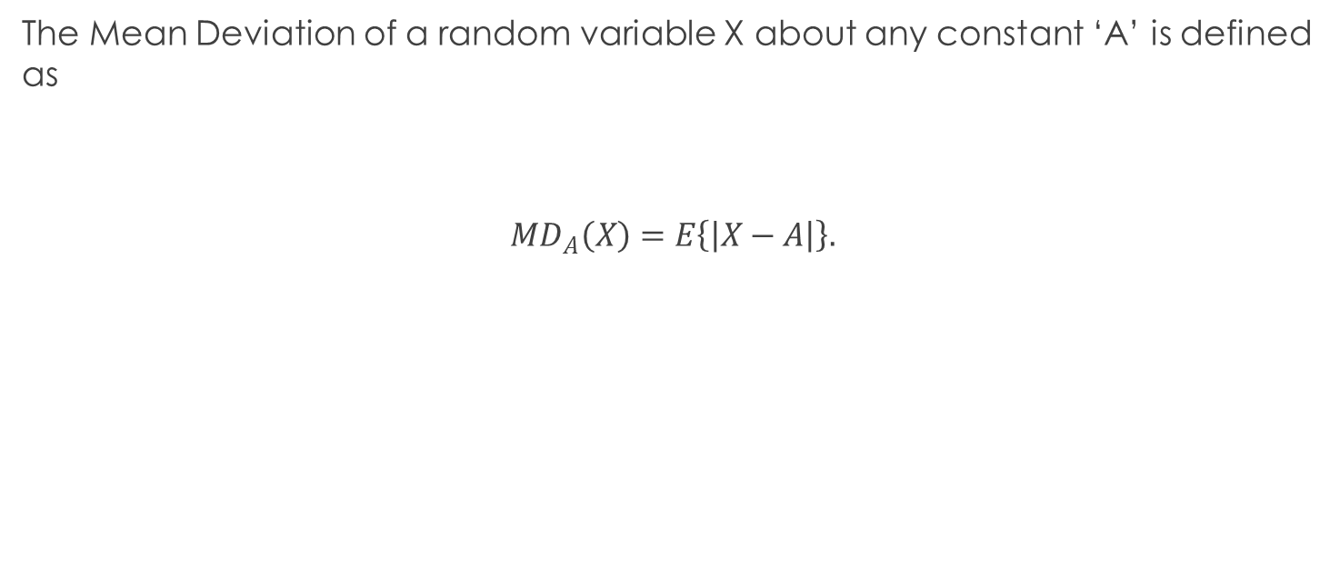
Mean Deviation
The Mean Deviation of a random variable X about any constant ‘A’ is defined as
$${MD}_{A}\left(X\right)=E\left\{\left|X−A\right|\right\}.$$

Slide 36
Moments

Slide 37
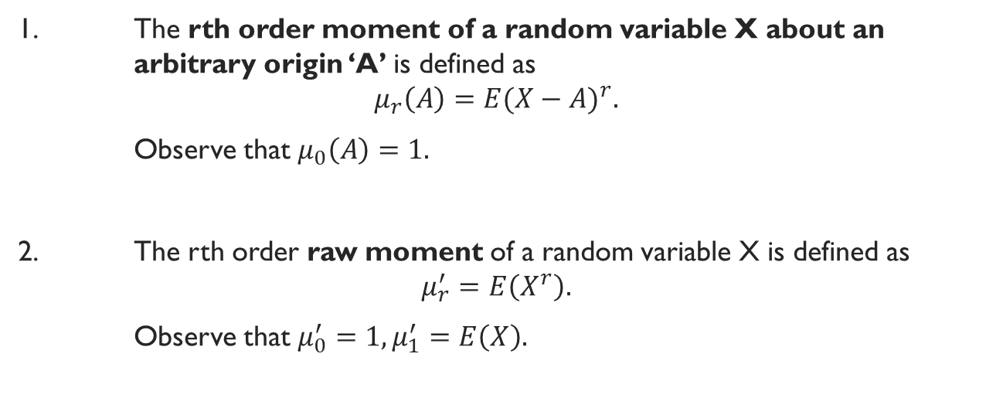
Different Moments
1. The rth order moment of a random variable X about an arbitrary origin ‘A’ is defined as
$$μ_{r}\left(A\right)=E{(X−A)}^{r}.$$
Observe that $μ_{0}\left(A\right)=1.$
2. The rth order raw moment of a random variable X is defined as
$$μ_{r}^{′}=E\left(X^{r}\right).$$
Observe that $μ_{0}^{′}=1,μ_{1}^{′}=E\left(X\right).$

Slide 38
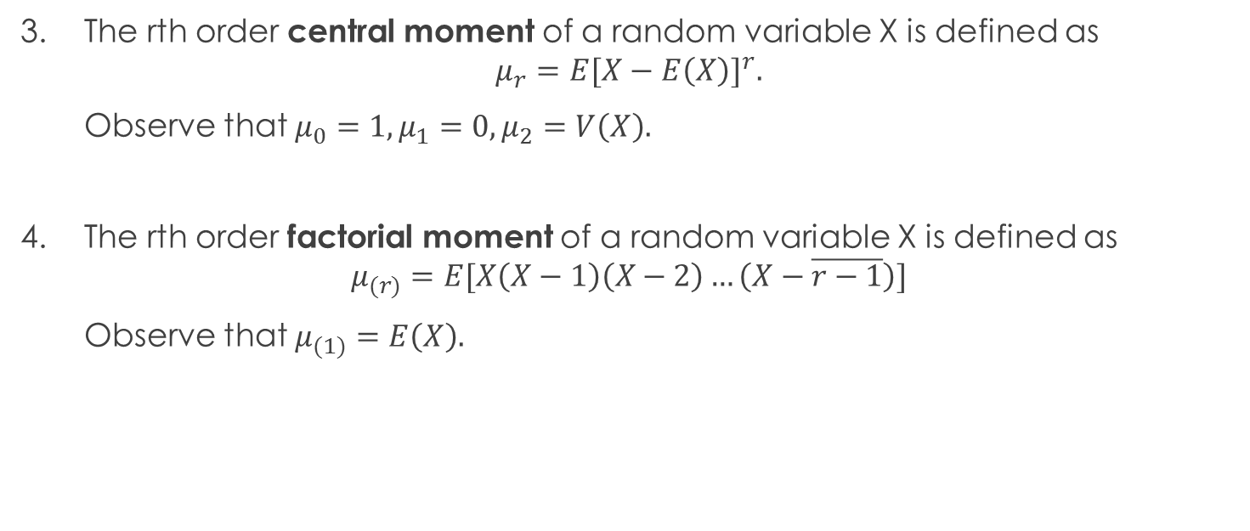
Different Moments Contd.
3. The rth order central moment of a random variable X is defined as
$$μ_{r}=E{[X−E\left(X\right)]}^{r}.$$
Observe that $μ_{0}=1,μ_{1}=0,μ_{2}=V\left(X\right).$
4. The rth order factorial moment of a random variable X is defined as
$$μ_{(r)}=E[X\left(X−1\right)\left(X−2\right)…\left(X−\overline{r−1}\right)]$$
Observe that $μ_{(1)}=E\left(X\right).$

Slide 39
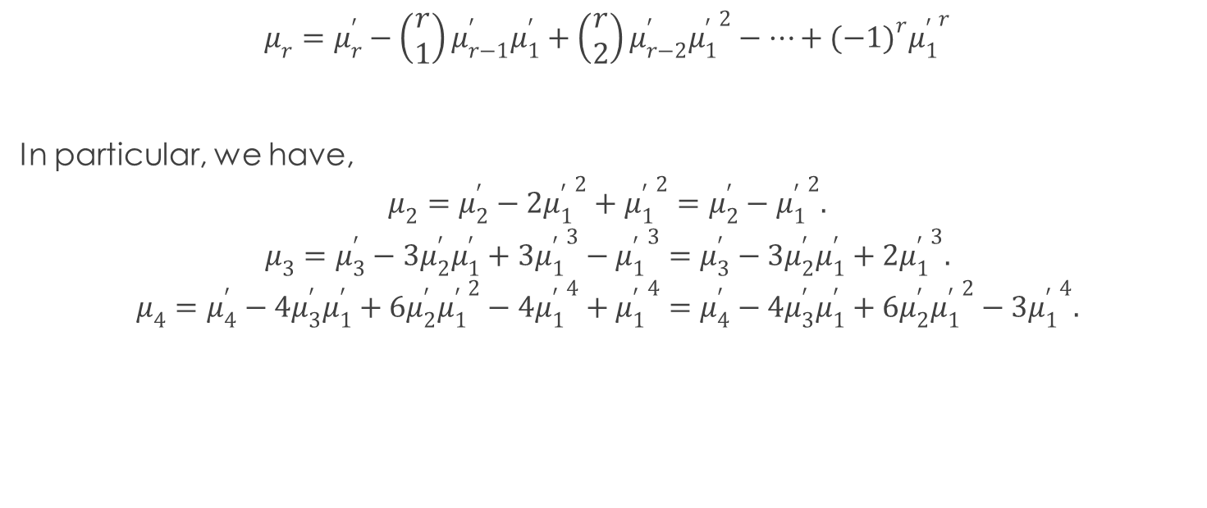
Expression of Central Moment in terms of Raw Moments
$$μ_{r}=μ_{r}^{′}−\left(\begin{matrix}r \\ 1\end{matrix}\right)μ_{r−1}^{′}μ_{1}^{′}+\left(\begin{matrix}r \\ 2\end{matrix}\right)μ_{r−2}^{′}{μ_{1}^{′}}^{2}−…+{(−1)}^{r}{μ_{1}^{′}}^{r}$$
In particular, we have,
$$μ_{2}=μ_{2}^{′}−2{μ_{1}^{′}}^{2}+{μ_{1}^{′}}^{2}=μ_{2}^{′}−{μ_{1}^{′}}^{2}.$$
$$μ_{3}=μ_{3}^{′}−3μ_{2}^{′}μ_{1}^{′}+3{μ_{1}^{′}}^{3}−{μ_{1}^{′}}^{3}=μ_{3}^{′}−3μ_{2}^{′}μ_{1}^{′}+2{μ_{1}^{′}}^{3}.$$
$$μ_{4}=μ_{4}^{′}−4μ_{3}^{′}μ_{1}^{′}+6μ_{2}^{′}{μ_{1}^{′}}^{2}−4{μ_{1}^{′}}^{4}+{μ_{1}^{′}}^{4}=μ_{4}^{′}−4μ_{3}^{′}μ_{1}^{′}+6μ_{2}^{′}{μ_{1}^{′}}^{2}−3{μ_{1}^{′}}^{4}.$$

Slide 40
Measures of Skewness and Kurtosis

Slide 41
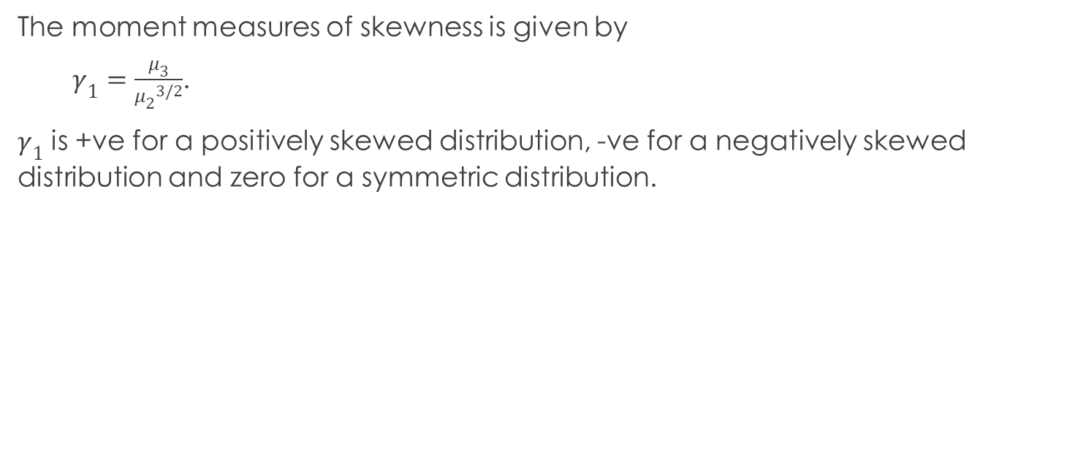
Skewness
The moment measures of skewness is given by
$γ_{1}=\frac{μ_{3}}{{μ_{2}}^{3/2}}$.
$γ_{1}$ is +ve for a positively skewed distribution, -ve for a negatively skewed distribution and zero for a symmetric distribution.

Slide 42
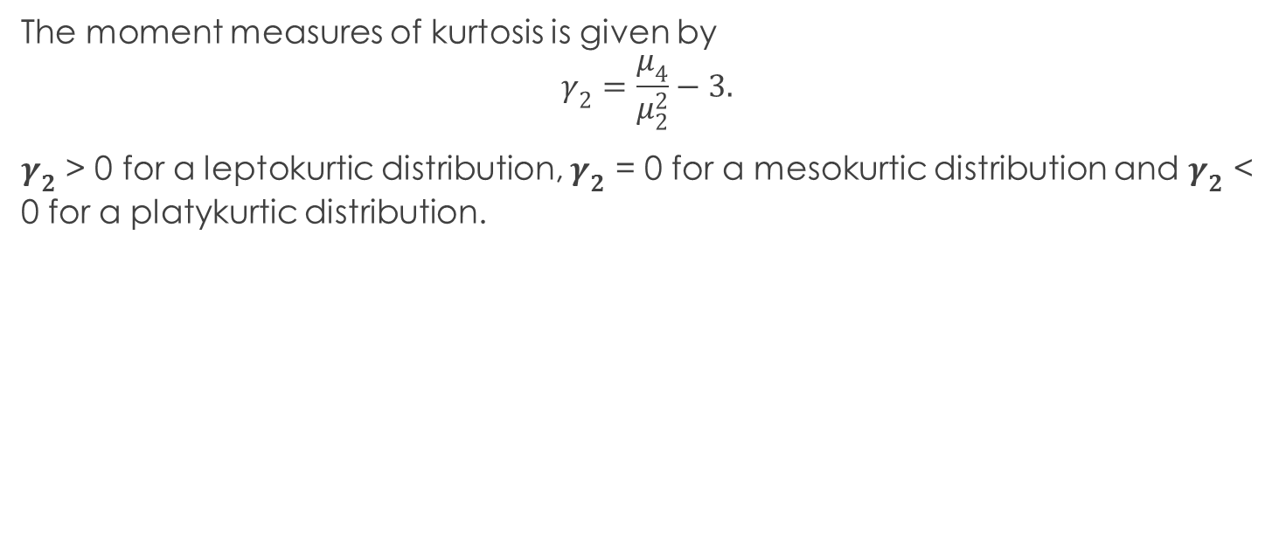
Kurtosis
The moment measures of kurtosis is given by
$$γ_{2}=\frac{μ_{4}}{μ_{2}^{2}}−3.$$
$γ_{2}$ > 0 for a leptokurtic distribution, $γ_{2}$ = 0 for a mesokurtic distribution and $γ_{2}$ < 0 for a platykurtic distribution.

Slide 43
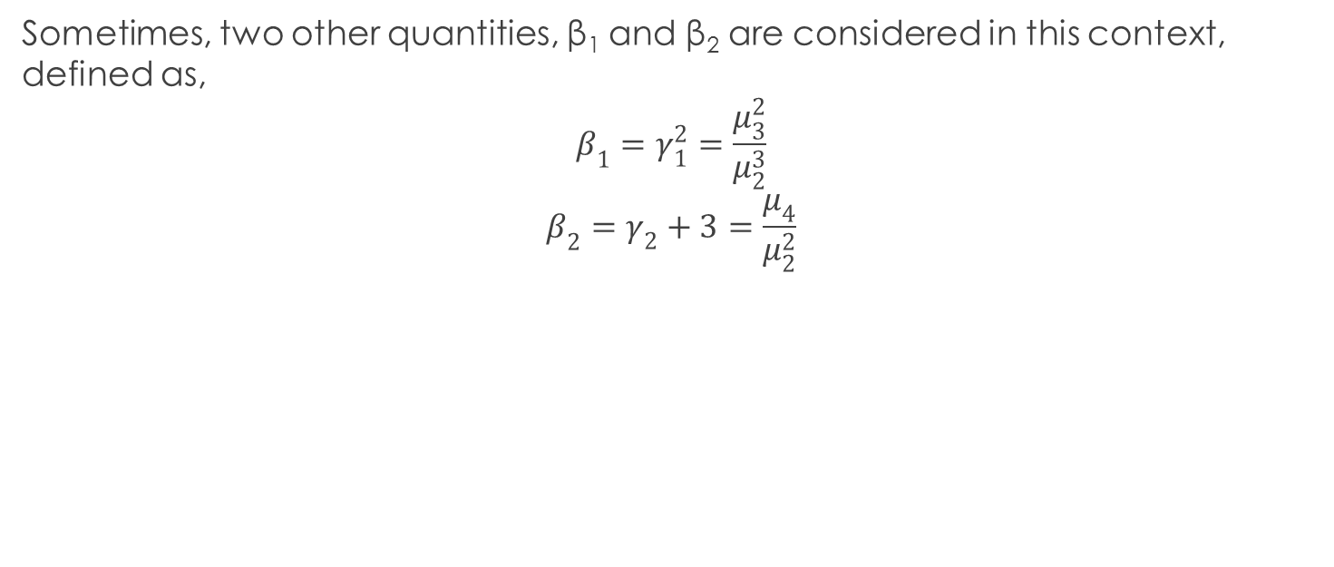
Note
Sometimes, two other quantities, β₁ and β₂ are considered in this context, defined as,
$$β_{1}=γ_{1}^{2}=\frac{μ_{3}^{2}}{μ_{2}^{3}}$$
$$β_{2}=γ_{2}+3=\frac{μ_{4}}{μ_{2}^{2}}$$

Slide 44
Sums
1. An urn contains N balls, among which some may be red. In fact, the number of red balls is a random variable whose expectation is known to be M. If a ball is drawn at random from this urn, what is the probability that it is red?
2. A person wants to open his door and has n keys. For some unknown reason, he tries the keys one by one at random. Find the mean and variance of the number of trials needed if
(a) the unsuccessful keys are not eliminated from further selection.
(b) if they are.

Slide 45
Sums
3. Suppose two players A and B are playing a game for Rs. 99. Both A and B will alternately throw an unbiased die. He, who first gets a ‘6’ will win the game. If A starts the game, what are the expected gains of A and B?

Slide 46
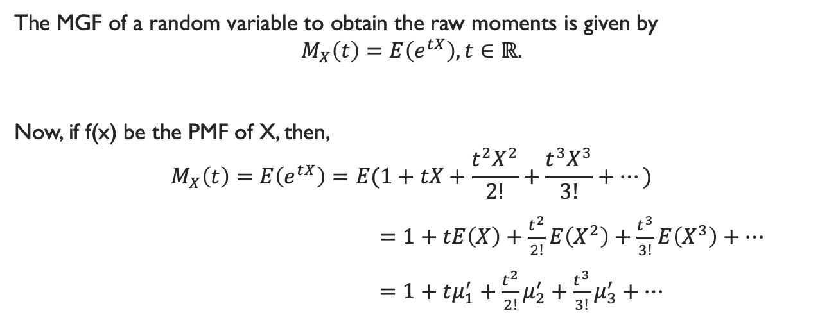
Moment Generating Function (MGF)
The MGF of a random variable to obtain the raw moments is given by
$$M_{X}\left(t\right)=E\left(e^{tX}\right), t∈ℝ.$$
Now, if f(x) be the PMF of X, then,
$$M_{X}\left(t\right)=E\left(e^{tX}\right)=E(1+tX+\frac{t^{2}X^{2}}{2!}+\frac{t^{3}X^{3}}{3!}+…)$$
$=1+tE\left(X\right)+\frac{t^{2}}{2!}E\left(X^{2}\right)+\frac{t^{3}}{3!}E\left(X^{3}\right)+…$
$=1+tμ_{1}^{′}+\frac{t^{2}}{2!}μ_{2}^{′}+\frac{t^{3}}{3!}μ_{3}^{′}+…$

Slide 47
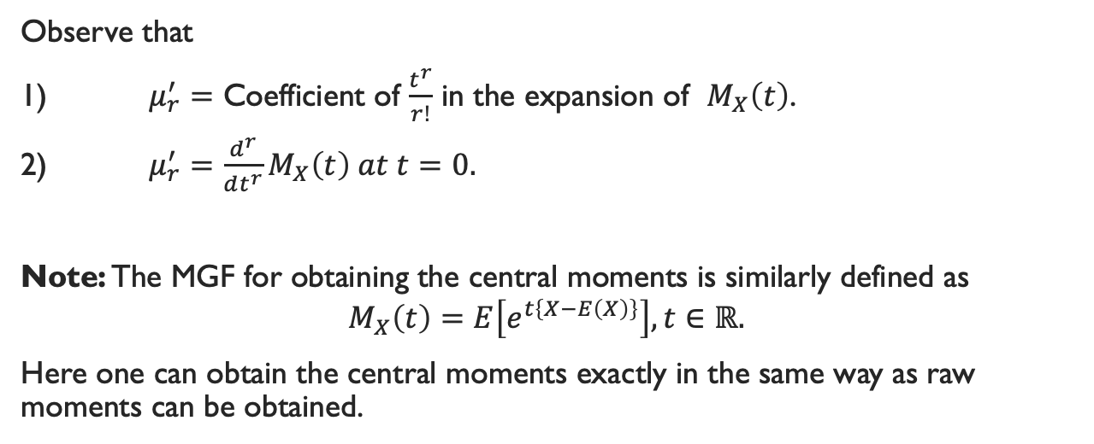
Moment Generating Function (MGF) Contd.
Observe that
1) $μ_{r}^{′}=$ Coefficient of $\frac{t^{r}}{r!}$ in the expansion of $M_{X}\left(t\right)$.
2) $μ_{r}^{′}=\frac{d^{r}}{dt^{r}}M_{X}\left(t\right) at t=0.$
Note: The MGF for obtaining the central moments is similarly defined as
$$M_{X}\left(t\right)=E\left[e^{t\left\{X−E\left(X\right)\right\}}\right],t∈ℝ.$$
Here one can obtain the central moments exactly in the same way as raw moments can be obtained.

Slide 48
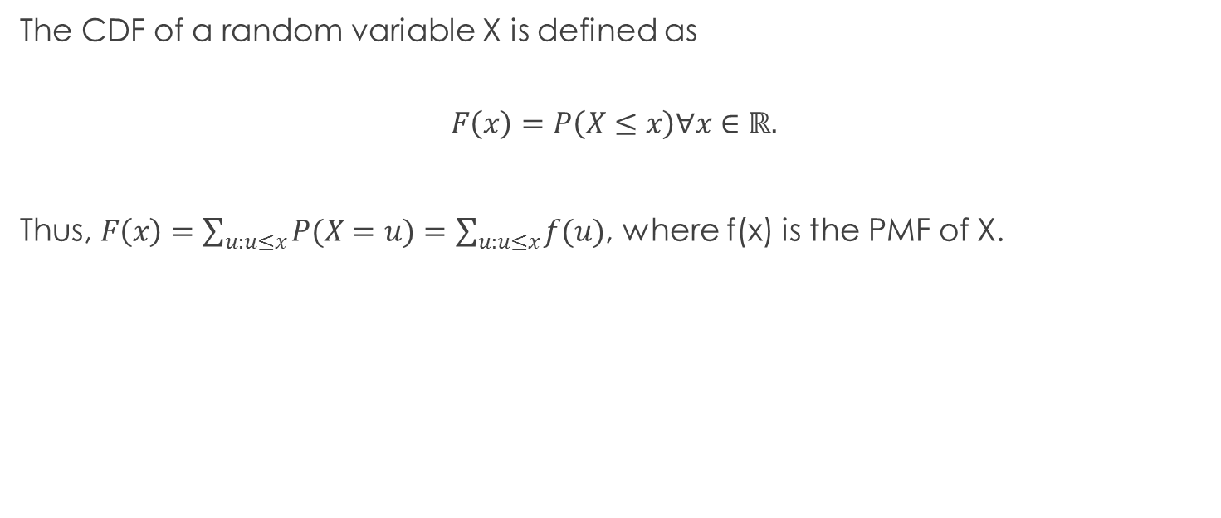
Cumulative Distribution Function (CDF) (or Distribution Function (DF))
The CDF of a random variable X is defined as
$$F\left(x\right)=P\left(X≤x\right)∀x∈ℝ.$$
Thus, $F\left(x\right)=\sum_{u:u≤x}{P(X=u)}=\sum_{u:u≤x}{f(u)}$, where f(x) is the PMF of X.

Slide 49
Example 1
Here F(6) = 1, F(∞) = 1., F(-1) = 0, F(-0.05) = 0, F(-∞) = 0.
x | 0 | 1 | 2 | 3 | 4 | Total
P(X = x) | 0.1 | 0.1 | 0.2 | 0.4 | 0.2 | 1
F(x) | 0.1 | 0.2 | 0.4 | 0.8 | 1 | -----

Slide 50
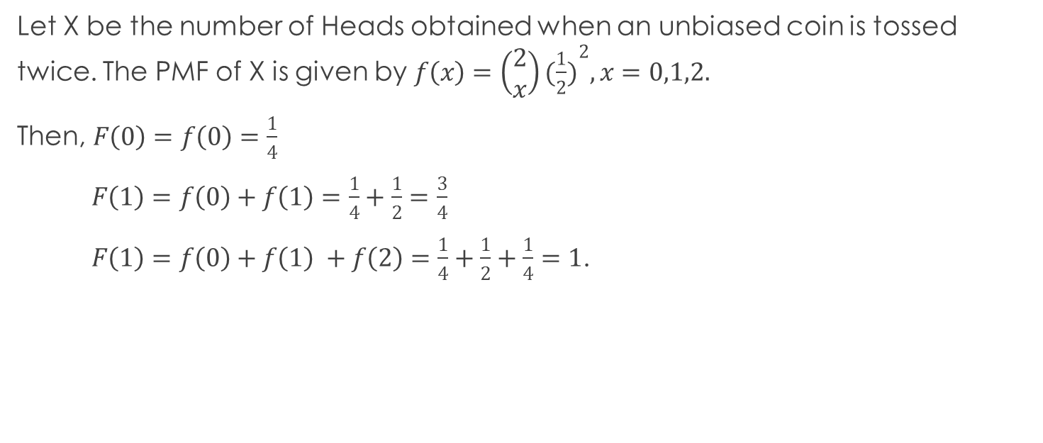
Example 2
Let X be the number of Heads obtained when an unbiased coin is tossed twice. The PMF of X is given by $f\left(x\right)=\left(\begin{matrix}2 \\ x\end{matrix}\right){(\frac{1}{2})}^{2}, x=0,1,2.$
Then, $F\left(0\right)=f\left(0\right)=\frac{1}{4}$
$F\left(1\right)=f\left(0\right)+f\left(1\right)=\frac{1}{4}+\frac{1}{2}=\frac{3}{4}$
$F\left(1\right)=f\left(0\right)+f\left(1\right) +f\left(2\right)=\frac{1}{4}+\frac{1}{2}+\frac{1}{4}=1$.

Slide 51
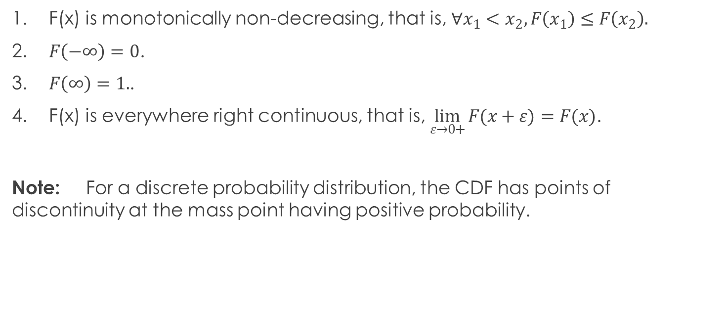
Properties of a CDF (Statement only)
1. F(x) is monotonically non-decreasing, that is, $∀x_{1}<x_{2}, F\left(x_{1}\right)≤F\left(x_{2}\right).$
2. $F\left(−∞\right)=0$.
3. $F\left(∞\right)=1.$.
4. F(x) is everywhere right continuous, that is, $\lim_{ε→0+}{F(x+ε)}=F(x)$.
Note: For a discrete probability distribution, the CDF has points of discontinuity at the mass point having positive probability.

Slide 52
Continuous Random Variable and its Probability Distribution

Slide 53
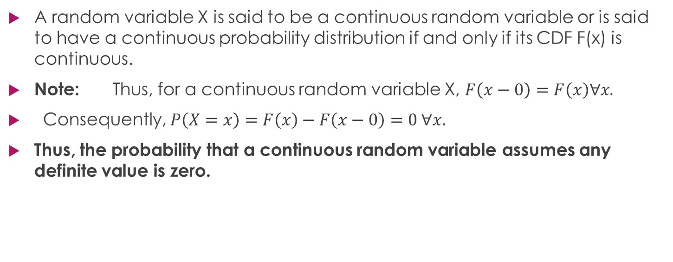
Continuous Random Variable
A random variable X is said to be a continuous random variable or is said to have a continuous probability distribution if and only if its CDF F(x) is continuous.
Note: Thus, for a continuous random variable X, $F\left(x−0\right)=F\left(x\right)∀x.$
Consequently, $P\left(X=x\right)=F\left(x\right)−F\left(x−0\right)=0 ∀x.$
Thus, the probability that a continuous random variable assumes any definite value is zero.

Slide 54
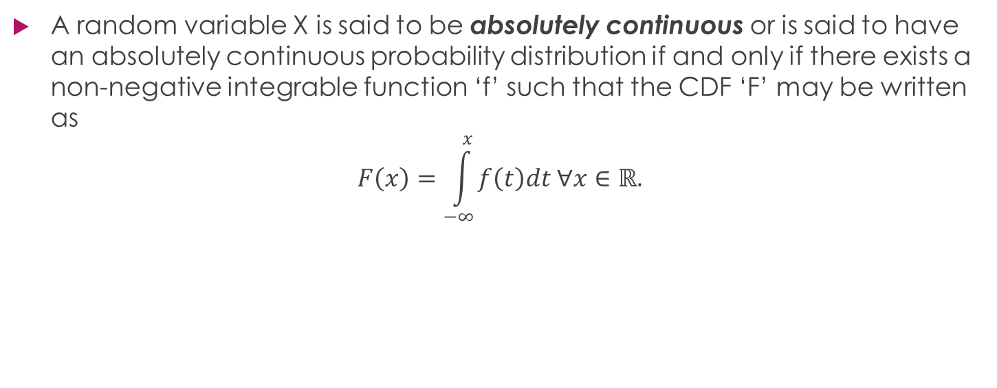
Definition
A random variable X is said to be absolutely continuous or is said to have an absolutely continuous probability distribution if and only if there exists a non-negative integrable function ‘f’ such that the CDF ‘F’ may be written as
$$F\left(x\right)=\int_{−∞}^{x}{f\left(t\right)dt ∀x∈ℝ.}$$

Slide 55
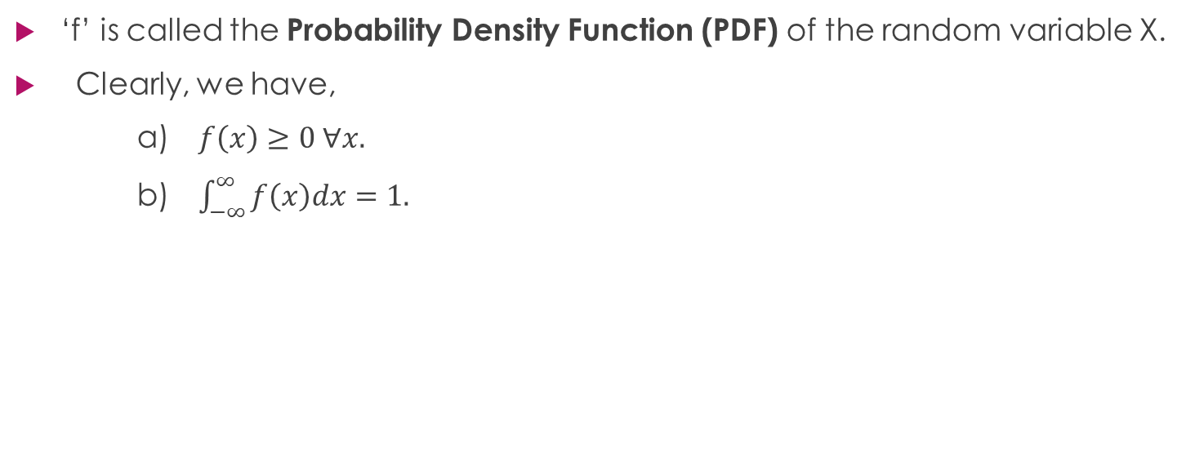
Note 1
‘f’ is called the Probability Density Function (PDF) of the random variable X.
Clearly, we have,
a) $f\left(x\right)≥0 ∀x.$
b) $\int_{−∞}^{∞}{f\left(x\right)dx=1.}$

Slide 56
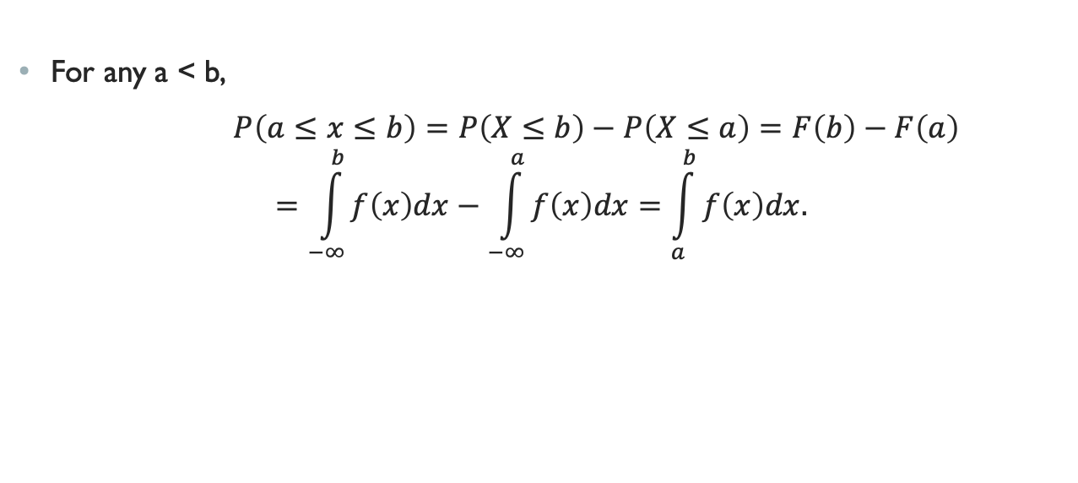
Note 2
For any a < b,
$P\left(a≤x≤b\right)=P\left(X≤b\right)−P\left(X≤a\right)=F\left(b\right)−F\left(a\right)$
$$=\int_{−∞}^{b}{f\left(x\right)dx−\int_{−∞}^{a}{f\left(x\right)dx=\int_{a}^{b}{f\left(x\right)dx.}}}$$

Slide 57

Note 3
We have,
$f\left(x\right)=\frac{d}{dx}F\left(x\right)=\lim_{h→0+}{\frac{F\left(x+h\right)−F(x)}{h}}=\lim_{h→0+}{\frac{P(x≤X≤x+h)}{h}}.$
Hence the term “Probability Density”.

Slide 58
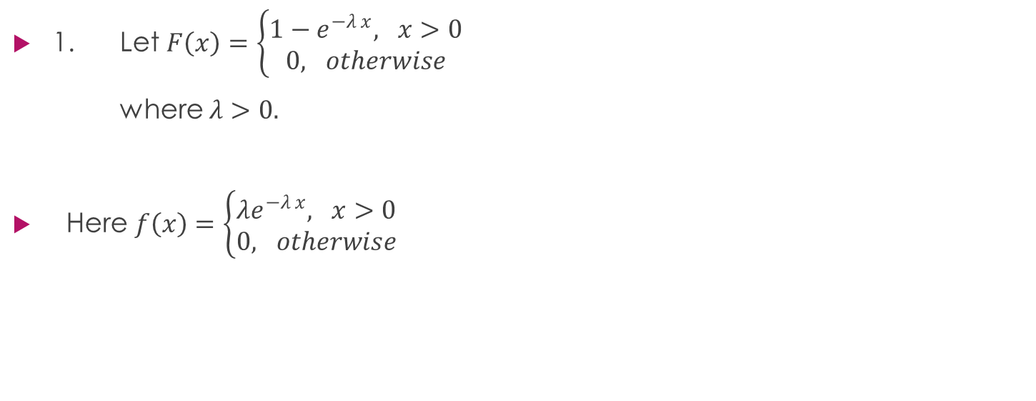
Examples
1. Let $F\left(x\right)=\left\{\begin{matrix}1−e^{−λ x}, x>0 \\ 0, otherwise\end{matrix}\right.$
where $λ>0.$
Here $f\left(x\right)=\left\{\begin{matrix}λe^{−λ x}, x>0 \\ 0, otherwise\end{matrix}\right.$

Slide 59
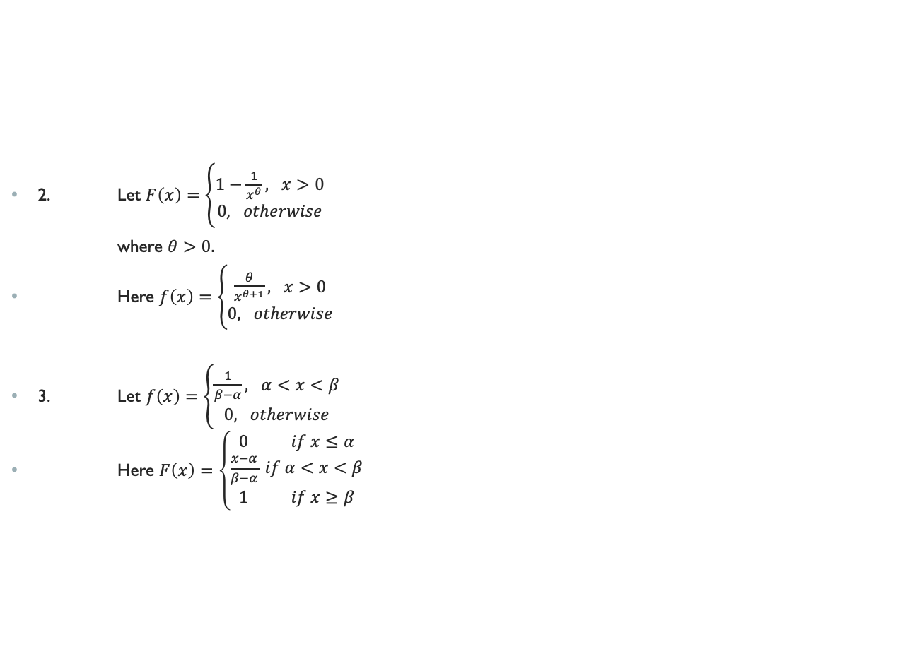
Examples Contd.
2. Let $F\left(x\right)=\left\{\begin{matrix}1−\frac{1}{x^{θ}}, x>0 \\ 0, otherwise\end{matrix}\right.$
where $θ>0.$
Here $f\left(x\right)=\left\{\begin{matrix}\frac{θ}{x^{θ+1}}, x>0 \\ 0, otherwise\end{matrix}\right.$
3. Let $f\left(x\right)=\left\{\begin{matrix}\frac{1}{β−α}, α<x<β \\ 0, otherwise\end{matrix}\right.$
Here $F\left(x\right)=\left\{\begin{matrix}0 if x≤α \\ \frac{x−α}{β−α} if α<x<β \\ 1 if x≥β\end{matrix}\right.$

Slide 60

Expectation (or Mathematical Expectation)
It is defined as:
$$E\left(X\right)=\int_{−∞}^{∞}{xf\left(x\right)dx.}$$
Let X be a continuous random variable and g(x) be a function of X. Then,
$$E[g\left(X\right)]=\int_{−∞}^{∞}{g(x)f\left(x\right)dx.}$$

Slide 61
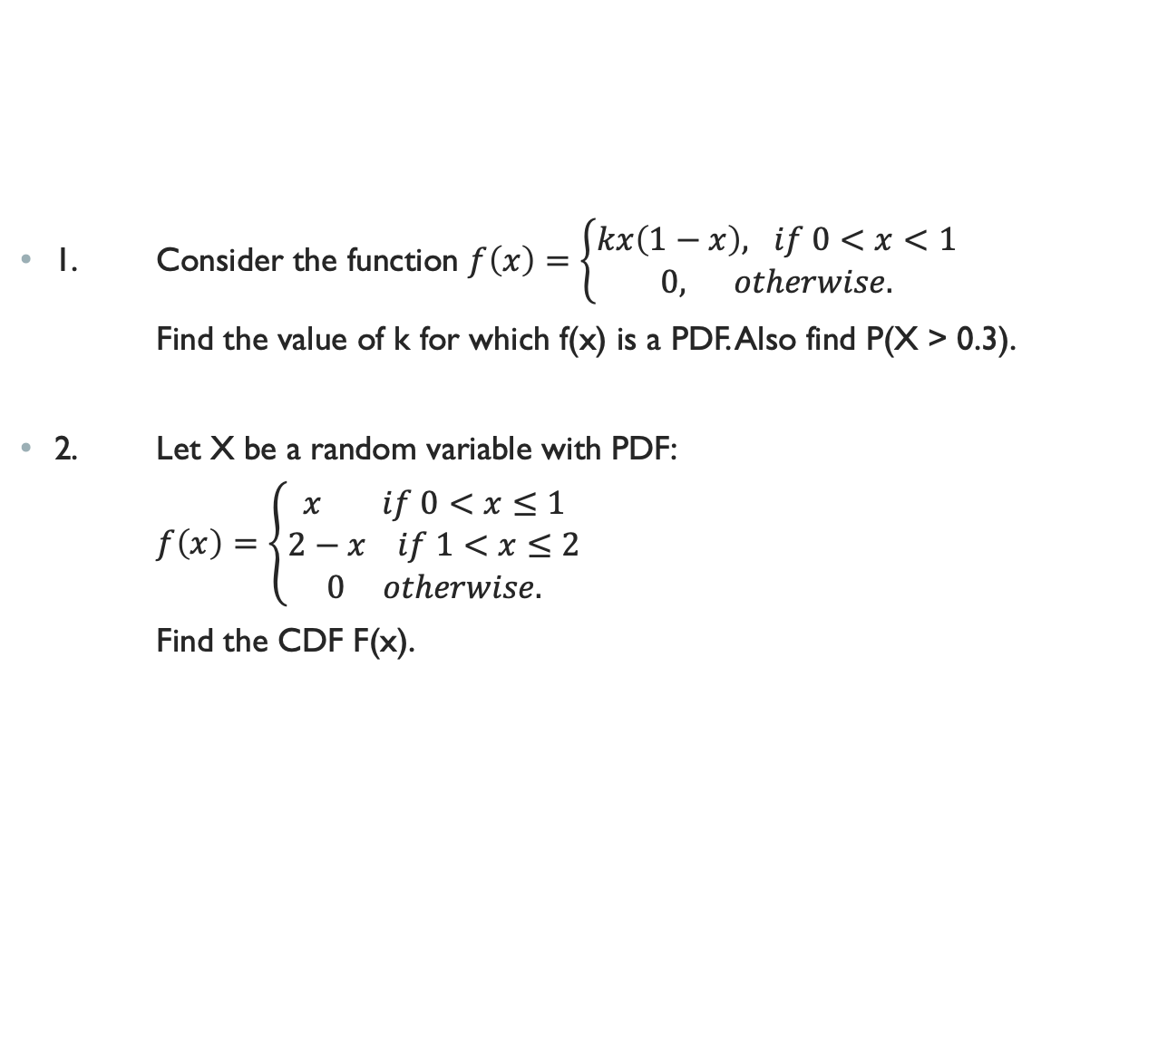
Some Problems
1. Consider the function $f\left(x\right)=\left\{\begin{matrix}kx\left(1−x\right), if 0<x<1 \\ 0, otherwise.\end{matrix}\right.$
Find the value of k for which f(x) is a PDF. Also find P(X > 0.3).
2. Let X be a random variable with PDF:
$f\left(x\right)=\left\{\begin{matrix}x if 0<x≤1 \\ 2−x if 1<x≤2 \\ 0 otherwise.\end{matrix}\right.$
Find the CDF F(x).

Slide 62

Some Problems Contd.
3. Examine whether the function
$F\left(x\right)=\left\{\begin{matrix}1−e^{−λ x}, x>0 \\ 0, otherwise\end{matrix}\right.$
where $λ>0,$
may be regarded as a CDF.

Slide 63

Some Problems Contd.
4. Consider the function:
$F\left(x\right)=\left\{\begin{matrix}0 if x≤0 \\ \frac{1}{3}x if 0<x≤1 \\ \frac{1}{3}+\frac{{\left(x−1\right)}^{2}}{2} if 1<x≤2 \\ \frac{6}{7}+\frac{{\left(x−2\right)}^{2}}{3} if x>2.\end{matrix}\right.$
Verify whether ‘F’ is a CDF.

Slide 64

Some Problems Contd.
5. Consider the function
$F\left(x\right)=\left\{\begin{matrix}0 if x≤0 \\ \frac{x^{2}}{2} if 0<x≤1 \\ \frac{1}{2}+\frac{1}{3}{(x−1)}^{3} if 1<x≤2 \\ \frac{6}{7}+\frac{1}{7}{(x−2)}^{4} if 2<x≤3 \\ 1 if x>3.\end{matrix}\right.$
Check whether F(x) is a CDF.

Slide 65
A Special Property
Let F₁ and F₂ be two CDFs. Show that any convex combination of F₁ and F₂ is also a CDF.

Slide 66
Mixed Random Variables
These are random variables that are neither discrete nor continuous, but are a mixture of both.
In particular, a mixed random variable has a continuous part and a discrete part.
Thus, we can use our normal tools to analyse them.

Slide 67

Example
Let X be a continuous random variable with the following PDF:
$$f\left(x\right)=\left\{\begin{matrix}2x, 0≤x≤1 \\ 0 otherwise.\end{matrix}\right.$$
Let also
$$Y=g\left(X\right)=\left\{\begin{matrix}X, 0≤X≤\frac{1}{2} \\ \frac{1}{2},X>\frac{1}{2}.\end{matrix}\right.$$
Find the CDF of Y.

Slide 68
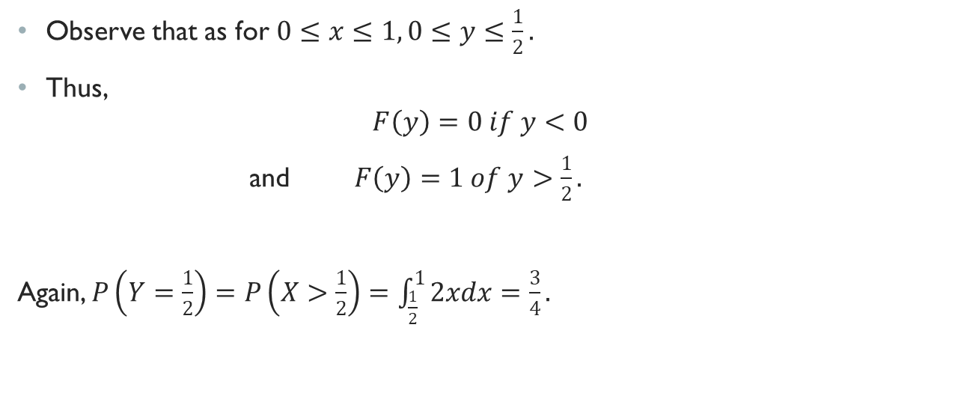
Solution
Observe that as for $0≤x≤1, 0≤y≤\frac{1}{2}.$
Thus,
$$F\left(y\right)=0 if y<0$$
and $F\left(y\right)=1 of y>\frac{1}{2}.$
Again, $P\left(Y=\frac{1}{2}\right)=P\left(X>\frac{1}{2}\right)=\int_{\frac{1}{2}}^{1}{2xdx}=\frac{3}{4}.$

Slide 69

Solution Contd.
Also, for $0<y<\frac{1}{2},$
$$F\left(y\right)=P\left(Y≤y\right)=P\left(X≤y\right)=\int_{0}^{y}{2xdx}=y^{2}.$$
The CDF of Y is then given by
$$F\left(y\right)=\left\{\begin{matrix}1 if y≥\frac{1}{2} \\ y^{2} if 0≤y<\frac{1}{2} \\ 0 otherwise.\end{matrix}\right.$$

Slide 70
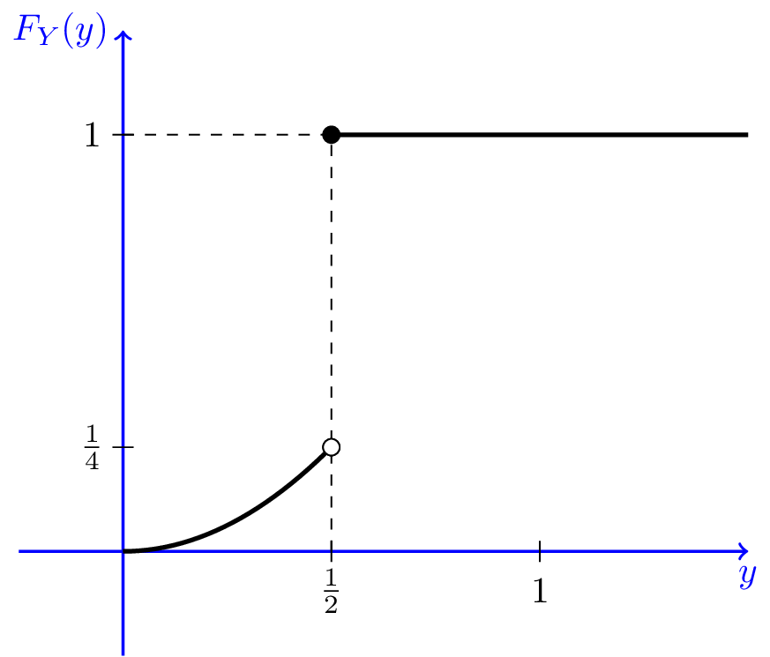
Graphical representation
The figure shows the CDF of Y.
We note that the CDF is not continuous, so Y is not a continuous random variable.
On the other hand, the CDF is not in the staircase form, so it is not a discrete random variable either.
It is indeed a mixed random variable.
There is a jump at y =1/2, and the amount of jump is 1−1/4 = 3/4, which is the probability that Y = 1/2. The CDF is continuous at other points.

Slide 71
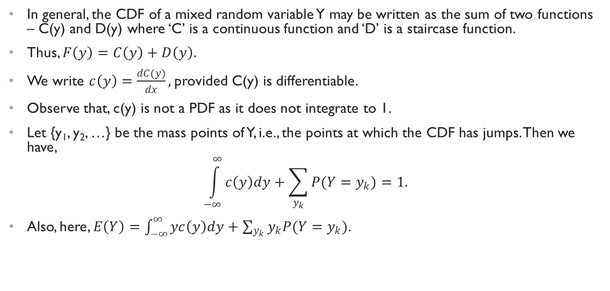
An Important Note
In general, the CDF of a mixed random variable Y may be written as the sum of two functions – C(y) and D(y) where ‘C’ is a continuous function and ‘D’ is a staircase function.
Thus, $F\left(y\right)=C\left(y\right)+D\left(y\right).$
We write $c\left(y\right)=\frac{dC(y)}{dx},$provided C(y) is differentiable.
Observe that, c(y) is not a PDF as it does not integrate to 1.
Let {y₁, y₂, …} be the mass points of Y, i.e., the points at which the CDF has jumps. Then we have,
$$\int_{−∞}^{∞}{c\left(y\right)dy}+\sum_{y_{k}}{P(Y=y_{k})}=1.$$
Also, here, $E\left(Y\right)=\int_{−∞}^{∞}{yc\left(y\right)dy}+\sum_{y_{k}}{y_{k}P(Y=y_{k})}$.

Slide 72

Present Example
$C\left(y\right)=\left\{\begin{matrix}\frac{1}{4},y≥\frac{1}{2} \\ y^{2}, 0≤y<\frac{1}{2} \\ 0, y<0.\end{matrix}\right.$
$D\left(y\right)=\left\{\begin{matrix}\frac{3}{4}, y≥\frac{1}{2} \\ 0, y<\frac{1}{2} \end{matrix}\right.$

